Slide 1
Understanding Harmonic Limits per IEEE519-2014
A Comparative Study of IEEE 519-2014 and IEEE 519-1992
Mahesh M. Swamy
Yaskawa America, Inc.
PP.AHR2016.01

Slide 2
Organization
Introduction
Fundamental shift in focus and Why?
Comparison of Harmonic guideline between IEEE 519-2014 and IEEE 519-1992
Introduction of Statistical Methods
Significance of new standard on capacitor based filters

Slide 3
Introduction
Voltage harmonics and system efficiency have been stressed heavily in new document
Current harmonics causes voltage harmonics – hence current harmonic control has been given due importance
System efficiency improvement has been stressed throughout the document

Slide 4
Fundamental Shift in Focus
Voltage and Current Harmonics have been explicitly mentioned to be System Specification and NOT Device Specification
Statistical Measurement has been Introduced and stressed
Utility is NOW involved in Harmonic Measurement – not the end user

Slide 5
Fundamental Shift in Focus
Power Conversion Group has been completely removed!
Standard is driven by Transmission / Distribution, i.e. Producers
* Front page of respective documents

Slide 6
Old revised to New
The new document overrides the old guideline since it is noted to be a revision
Front page of respective documents

Slide 7
Interesting Comparison Fact
IEEE 519-1992 is a 101 page document and is a “teaching or tutorial” document
In IEEE 519-2014 is only a 29 page document and there is NO attempt to educate the reader on reactive power control or harmonic current control

Slide 8
Point of Common Coupling
In IEEE 519-1992, point of common coupling (PCC) is vaguely defined and is open to multiple interpretations
In IEEE 519-2014, PCC is very well defined. PCC is not at the equipment but is a “Point on a Public Power Supply System”.

Slide 9
PCC Differences between 519-1992 and 519-2014
In IEEE 519-1992, point of common coupling (PCC) is also defined as follows: “Within an industrial plant, the PCC is the point between the nonlinear load and other loads.”

Slide 10
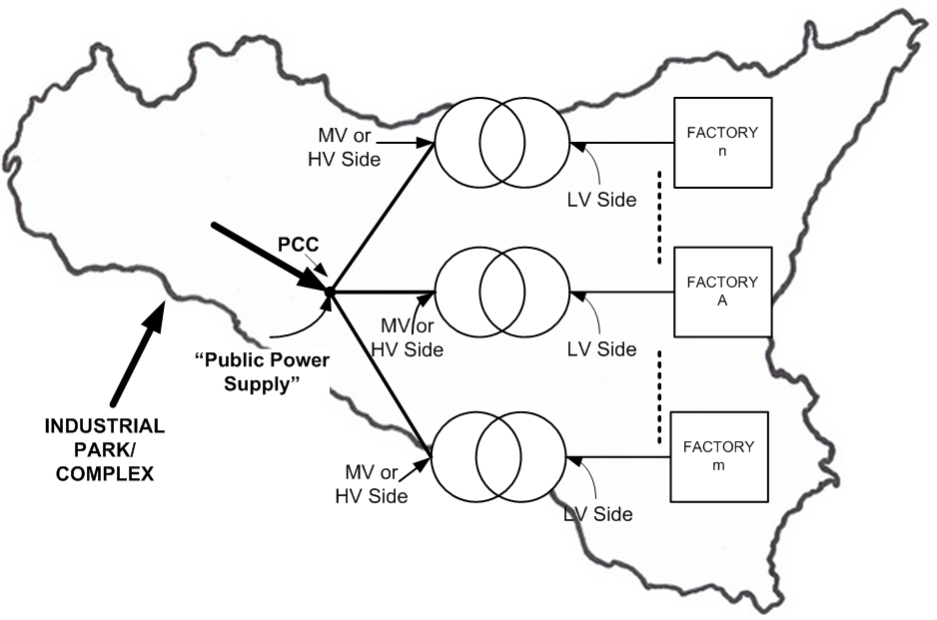
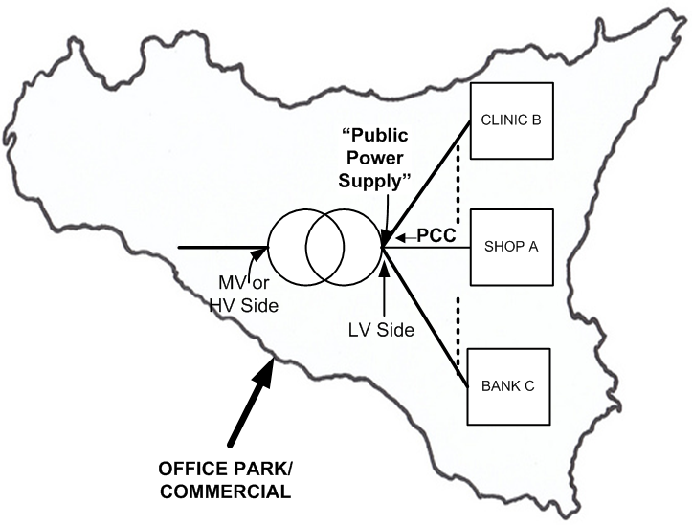
PCC Differences between 519-1992 and 519-2014
In IEEE 519-2014, PCC is: “Frequently for service to industrial users (i.e., manufacturing plants) via a dedicated service transformer, the PCC is at the HV side of the transformer. For commercial users (office parks, shopping malls, etc.) supplied through a common service transformer, the PCC is commonly on the LV side of the service transformer.”

Slide 11
Key Departure from the PAST
“The recommended limits in this clause apply only at the point of common coupling and should not be applied to either individual pieces of equipment or at locations within a user’s facility.”
“In most cases, harmonic voltages and currents at these locations could be found to be significantly greater than the limits recommended at the PCC due to lack of diversity, cancellation, and other phenomenon that tend to reduce the combined effects of multiple harmonic sources to levels below their algebraic summation.”
This is a Major change, if not the elimination of, the OLD and controversial way of dealing with harmonics.

Slide 12
Total Demand Distortion - Differences between 519-1992 and 519-2014
In 519-1992, the definition of was based on the maximum load current - measurement period was 15 minutes or 30 minutes
In Section 5.2, of IEEE 519-2014, in the definition for TDD, the maximum demand current is used and is defined as:
“This current value is established at the point of common coupling and should be taken as the sum of the currents corresponding to the maximum demand during each of the twelve previous months divided by 12”
Major shift in focus – It has shifted from short term to LONG term, stressing energy efficiency aspect of Harmonic Control

Slide 13
System Impedance Manipulation Addressed in 519-2014
In IEEE 519-2014, system impedance manipulation by end user has been strictly curtailed. It says, “…users should not add passive equipment that affects the impedance characteristic in a way such that voltage distortions are increased.”
Explanation: Capacitors offer low impedance to harmonic currents. Flow of harmonic current into capacitors through system impedance increases system voltage distortion. Use of capacitors in filters (both active and passive) has now been restricted and the end user will be responsible if capacitor increases voltage distortion.

Slide 14
Statistical Evaluation
Harmonic measurement will get more statistical – each frequency component packet (3-sec packet) need to be tracked for 1 day, 7 days, and 12 months!
1 day = Very Short Term; and
7 days= Short Term

Slide 15
Harmonic Voltage Limits – IEEE 519-2014
99th percentile value (value that is exceeded for 1% of the measurement period) should be calculated for each 24-hr period for comparison with the recommended limits in Cl. 5.
95th percentile value (values that is exceeded for 5% of the measurement period) should be calculated for each 7-day period for comparison with the recommended limits in Cl. 5.

Slide 16
Current Distortion Limits – IEEE 519-2014
99th percentile value (value that is exceeded for 1% of the measurement period) should be calculated for each 24-hr period for comparison with the recommended limits in Cl. 5.
95th percentile value (values that is exceeded for 5% of the measurement period) should be calculated for each 7-day period for comparison with the recommended limits in Cl. 5.

Slide 17
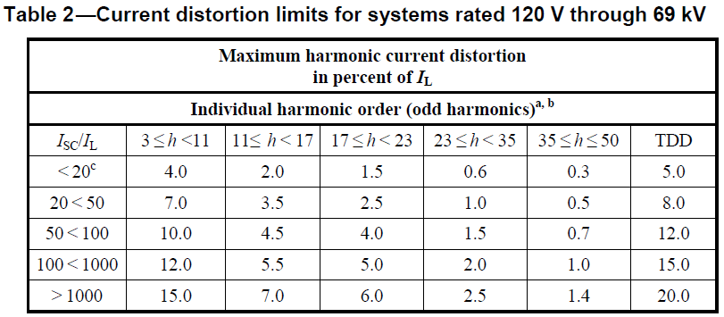
Current Distortion Limits – IEEE 519-2014

Slide 18
Conclusions
IEEE 519-2014 is a very relaxed guideline
Clearly identifies PCC and mentions it very clearly that measurement should NOT be at the device input
Stresses Long Term Averaging and strongly recommends use of Maximum Demand Current based on 12 month study
Also, for Industrial Customers, measurement is to be done on HV side of service transformer and many end users are NOT qualified to make such measurements

Slide 19
Conclusions
Comes down hard on topologies that change the “System Impedance Characteristics” – clearly topologies that have large input capacitors should be carefully evaluated.
Adding an input AC reactor or a DC link choke is perhaps the most promising and sufficient solution depending on the system.
Distributing the load into phase shifted buses at the service entrance would seem to be the most cost effective way of dealing with Harmonics in Commercial and Industrial plants.

Slide 20
Final Thoughts
“As power quality considerations evolve Yaskawa has a continued opportunity and responsibility to recommend equipment and countermeasures which both allow the customer to enjoy best value (cost) and highest system efficiency.
With the changes discussed, VFDs can be justified in more and more applications.

Slide 21
Visit us in Booth #1814 for an ice cream treat
from 1:00pm till 3:00pm Tuesday, Jan. 26th

